Slide 1

How to fill out Time Cards
ORB University
Track your progress
ORB UNIVERSITY – MAY 09, 2023
PRESENTED BY Andres Fernandez, Erika George, Laura Davidson

Slide 2
CORE – TIME CARDS
ORB uses CORE to track the amount of time spent on a project. Keeping track of time is just as important as any other aspect of the project.
CORE allows ORB to allocate the time that future projects will require and not have people overworked while truthfully and accurately provide invoices to clients
Be sure to add the web link to CORE in your favorites tab.

Slide 3
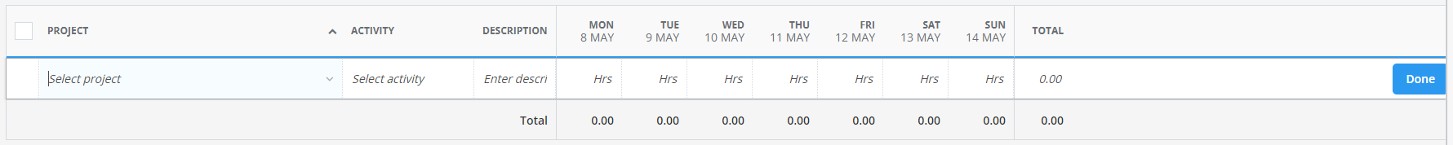
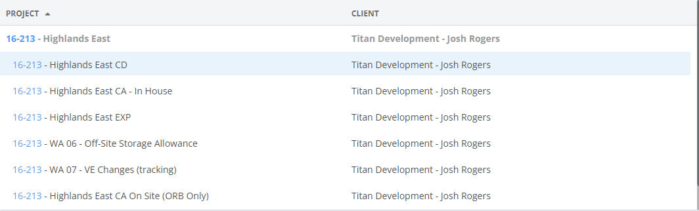
TIME CARD FIELDS
16-213
Choose the correct phase of the project.
Confirm with your Project Manager to make sure your time for a specific task is allocated in the correct location.

Slide 4
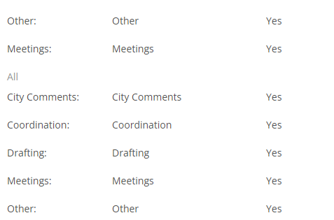
TIME CARD FIELDS
Choose the correct activity.
We do more than drafting (modeling) or have meetings

Slide 5
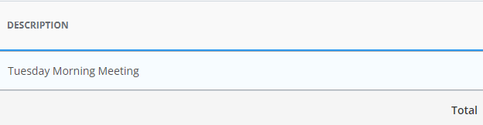
TIME CARD FIELDS
Provide a brief but accurate description of the work you are doing. If your entry relates to a field report, please indicate which # it applies to. (i.e., field report #9)
Note: Please avoid the use of special characters & quotations; this skews the report layout ran by Accounting for calculating client invoicing.

Slide 6
TIME CARD FIELDS
These fields are visible to clients. Be mindful of what you write in them
Clients are provided with a detailed report of time and activities spent on the project. If the description field if vague or does not accurately reflect the progress for that time, the client will rightfully question it.
Accurate descriptions give the client a sense of security and they see we are not wasting their money needlessly

Slide 7
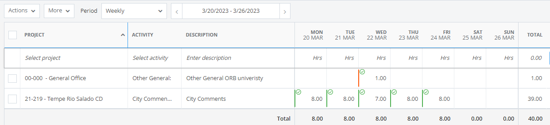
TIME CARD FIELDS
If you are working on only one project, it is best if you give descriptions of different tasks.
This shows work related to city comments, but you can break it down further by giving specifics: Life Safety Plans / Site Plan Dimensions / Enlarged Slab plans, etc.
This also give ORB a sense of where we are spending the most amount of time and if additional resources need to be allocated.

Slide 8
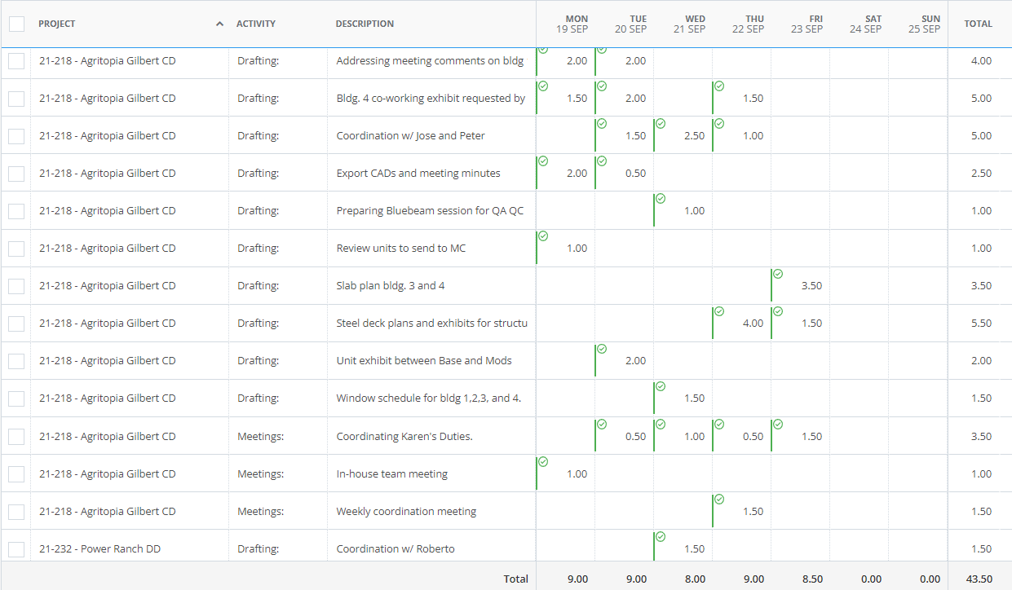
TIME CARD FIELDS
There can be also too much information. While it is good to keep track of what you are doing, this much detail can overwhelm, or it ends up being un-usable due to the fragmented nature of the tasks.

Slide 9
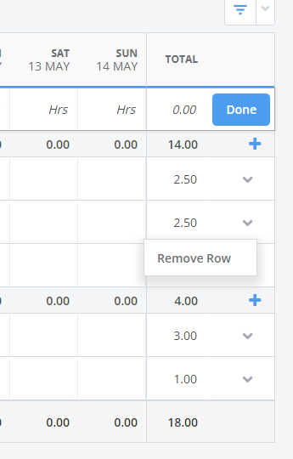
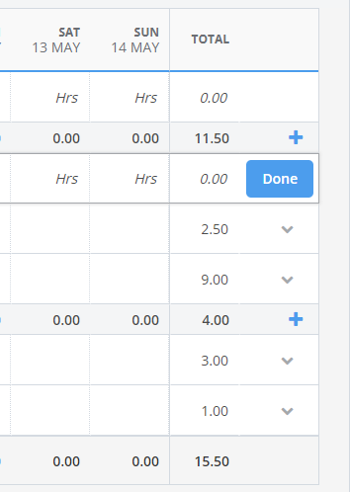
TIME ALLOCATION
If you make a mistake, you can click on the pull down tab and choose “Remove Row”. This will eliminate the entire row so be careful if you don’t want your time from a different day to be eliminated.
Time blocks can only be in 0.5 hour increments, i.e. 0.5 hrs, 1 hr, 1.5 hrs, etc.
Once you are done with your time entry, press the DONE button at the end of the row to ensure your time is registered.

Slide 10
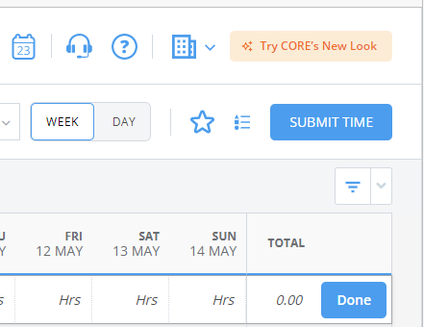
FINISHING YOUR TIME CARD
When you are done with your timecard for the week, click on the “SUBMIT TIME” button, located on the upper right-hand corner of the screen.

